Slide 1




Predicting Song Popularity
Explaining song popularity from audio and text features
ABUBACKER, Mohamed Nafees
CARILLO, Jella Marie
CHEN, Min
DORVEAUX, Thomas

Slide 2



Motivation
Listening to music has been completely transformed by music streaming services
Artists and the music distributors are compelled to discover innovative ways to predict what their customers like

Slide 3
Problem Definition
1
What contributes to a song’s popularity?
2
How accurately can we predict if a song is popular or not?

Slide 4


Methodology
Methodology
Data description
Data cleaning
Feature Engineering
Feature Selection
Model building & Training

Slide 5

Data Description
232,725 Songs with music features
57,650 Lyrics
5,261
Total songs in the final database used
The final database is an inner merge of two Kaggle databases

Slide 6
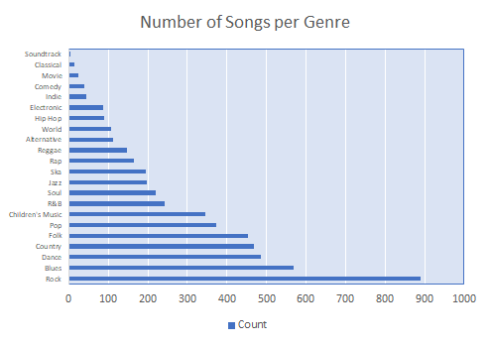
Data Description
Spotify feature | Characteristics
duration_ms | length of the song (ms)
key | key of the track (C♯, C, D, etc.)
mode | major or minor (1 or 0)
time_signature | beats by bar (4 different types)
acousticness | measure of acousticness (from 0 to 1)
danceability | measure of danceability (from 0 to 1)
energy | measure of intensity (from 0 to 1)
instrumentalness | measure of vocalness (from 0 to 1)
liveness | is there an audience? (from 0 to 1)
loudness | measure of loudness (dB)
speechiness | spoken words in the track (from 0 to 1)
tempo | beats per minutes (BPM)
valence | measure of happiness (from 0 to 1)

Slide 7

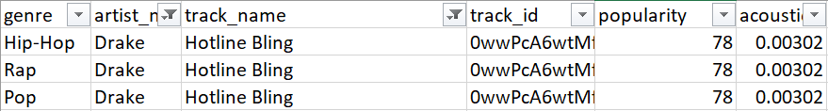
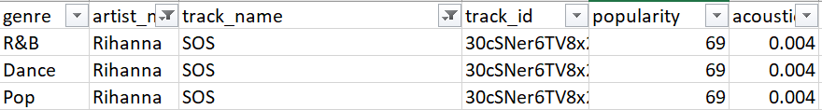
Data Cleaning
Eliminating repetition
Lyrics cleaning
Eliminating repetition
Lyrics cleaning
Pre-cleaning
[Verse 1] \nLoving can hurt, loving can hurt sometimes. \nBut it's the only thing that I know. \nWhen it gets hard, you know it can get hard sometimes, \nIt is the only thing that makes us feel alive. \n \n[Pre-Chorus] \nWe keep this love in a photograph. \nWe made these memories for ourselves. \nWhere our eyes are never closing, \nOur hearts are never broken, \nAnd time's forever frozen, still. \n \n[Chorus] \nSo you can keep me \nInside the pocket of your ripped jeans.
Post-cleaning
Loving can hurt, loving can hurt sometimes. But it's the only thing that I know. When it gets hard, you know it can get hard sometimes, It is the only thing that makes us feel alive. We keep this love in a photograph. We made these memories for ourselves. Where our eyes are never closing, Our hearts are never broken, And time's forever frozen, still. So you can keep me Inside the pocket of your ripped jeans.
Removed song repetitions (same song, different genre)
Method: Sort first by popularity, then retain the one with the highest popularity
Removed indicator words such as [Verse] and [Chorus]
Removed new lines, tabs, and additional spaces

Slide 8


Feature engineering
Classifying the dependent variable
Designing sentimental features
Improving musical features
Encoding categorical data

Slide 9
Feature Engineering: Methodology
Musical features:
Duration, liveness, acousticness
Key (C, D, etc.…)
Mode (Major, Minor)
Lyrical features:
Repetitiveness
Positiveness
Negativeness
Musical features
Popularity
Lyrical features
Notes:
Based on spotify, based on text analysis

Slide 10
Classifying Popularity
CLASS 1
75th quantile
CLASS 0
Notes:
Two reasons : poor result and from a business point of view : studio or producer; add number of songs per class

Slide 11



Buidling Sentimental features
Track
+1
Positive feature
S > 0.5
Sentiment analyser
S
-0.5 < S < 0.5
crying
+1
Neutral feature
good
sun
S < -0.5
+1
Negative feature
Library NLTK
Notes:
+ senti_total + speechiness

Slide 12
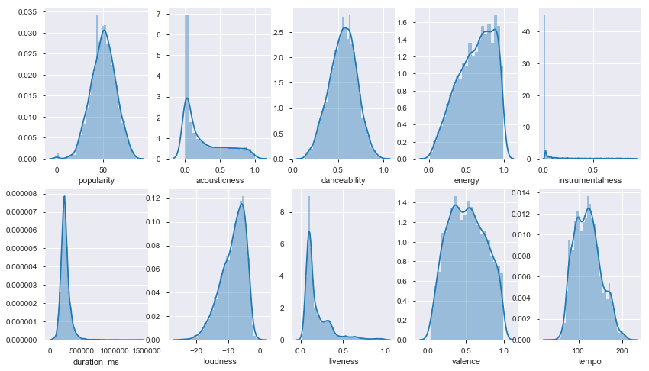
Distribution of musical features

Slide 13
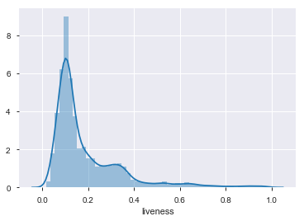
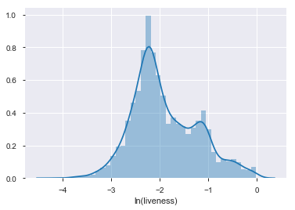
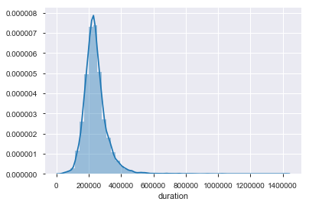
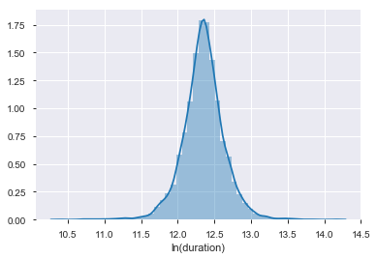
Logarithmic scaling
liveness
duration

Slide 14
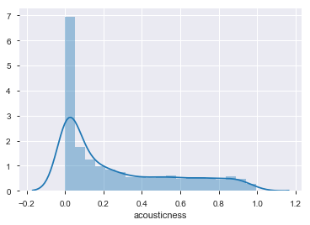
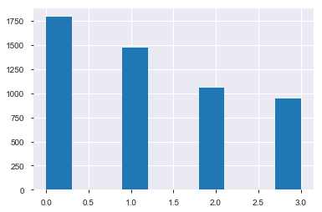
Categorization
Using k means we can split acousticness into 4 categories to get a cleaner discrete distribution thanks to K-means algorithm

Slide 15
Encoding
Numerical features
(positiveness, loudness)
Categorical features:
(artist_name, key, class_acousticness)
Total features : 475
(high dimensionality)
Notes:
From 20 to 475 variables due to the encoding of the artist

Slide 16
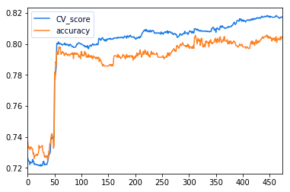
Feature Selection
Qn: What is the minimum number of features?
Iteration through logistic regrssion
Stepwise increase on number of features
Result: 60 features is used as baseline

Slide 17
Feature Selection
Qn: How to find the best features?
Variance Threshold | SelectKbest | RandomForest | RFE
track_length | compression_rate | genre_pop | compression_rate
liveness | instrumentalness | genre_rock | instrumentalness
loudness | label_acou_3/4 | compression_rate | genre_alternative
tempo | key_C# | loudness | genre_blues
senti_%+ | mode_Minor | energy | genre_classical
Variance Threshold
(0.1 threshold)
SelectKbest (Chi2 score)
Use multiple methods to locate the best features
Top 60 features are kept
Result:
Variance threshold generates 14 features
Top 60 features selected by the other three methods differ significantly
RandomForest Classifier
Recursive Feature Elimination

Slide 18
Model building
Input Features
Model
Output
Logistic Regression
Random Forest (60)
Cross Validation Score
Random Forest
SelectKbest (60)
Prediction accuracy
K-Nearest Neighbors(KNN)
Recursive Feature Elimination (60)
Receiver operator Characteristic Curve
Decision Tree
All feature (476)
Area Under Curve
Variance
Threshold (14)
Support Vector Machine(SVM)
AdaBoost

Slide 19
Evaluation Metrics
Cross Validation Score
Prediction Accuracy
Receiver Operator Characteristic Curve
10 fold cross validation
Mean score
Variance of the scores
75% as baseline
Comparison across classifiers and features
Shape of the curve
Area under the curve

Slide 20
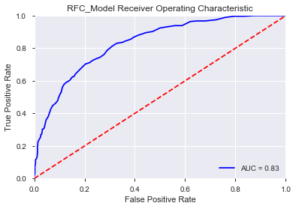
Results & Evaluation Summary of Results
CLASSIFIER | BEST FEATURE | ACCURACY
Logistic Regression | RFE Features | 0.793
Random Forest | All Features | 0.797
K-Nearest Neighbours | RFE Features | 0.786
Decision Tree | Chi_2 features | 0.792
Support Vector | RFE Features | 0.7914
AdaBoost | RFE Features | 0.787
LOGISTIC REGRESSION | ALL FEATURES | HIGHEST AUC
Random Forest has shown to be the best performing model with the highest accuracy of 0.797 among the six models with all 475 features

Slide 21
Results & Evaluation 10-Fold Cross Validation
CLASSIFIER | MEAN CV SCORE | VARIANCE
Logistic Regression | 0.737 | 3.952e-7
Random Forest | 0.806 | 3.531e-4
K-nearest Neighbour | 0.707 | 9.188e-4
Decision Tree | 0.796 | 2.267e-4
SVM | 0.726 | 3.953e-7
AdaBoost | 0.807 | 2.321e-4
Most Stable
Least Stable
Logistic Regression has the lowest variance hence most consistent performance. Whereas K-nearest neighbour has shown to be least stable model with the highest variance from the 10 folds cross validation score.

Slide 22
Conclusion
Our model can predict whether a song will become popular with 79.7% accuracy.
We obtain this by using RANDOM FOREST model (Binary Classification) with 475 song features ranging from song’s loudness to lyric’s sentiment
Similar accuracy is achieved through using feature selection methods (Decision Tree + Chi2 = 79.72% accuracy)
We opted classification instead of regression models because it correlates with the business needs.

Slide 23

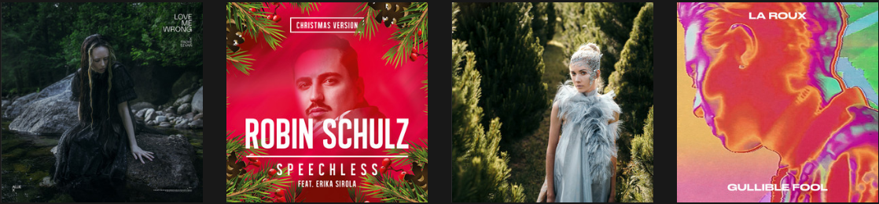




THANK YOU

